Slide 1

Notes:
This is a presentation on code quality

Slide 2

Notes:
So, I was hanging out at work one day

Slide 3
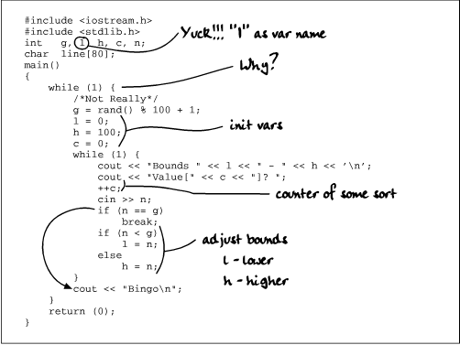
Notes:
Fixing code and stuff

Slide 4
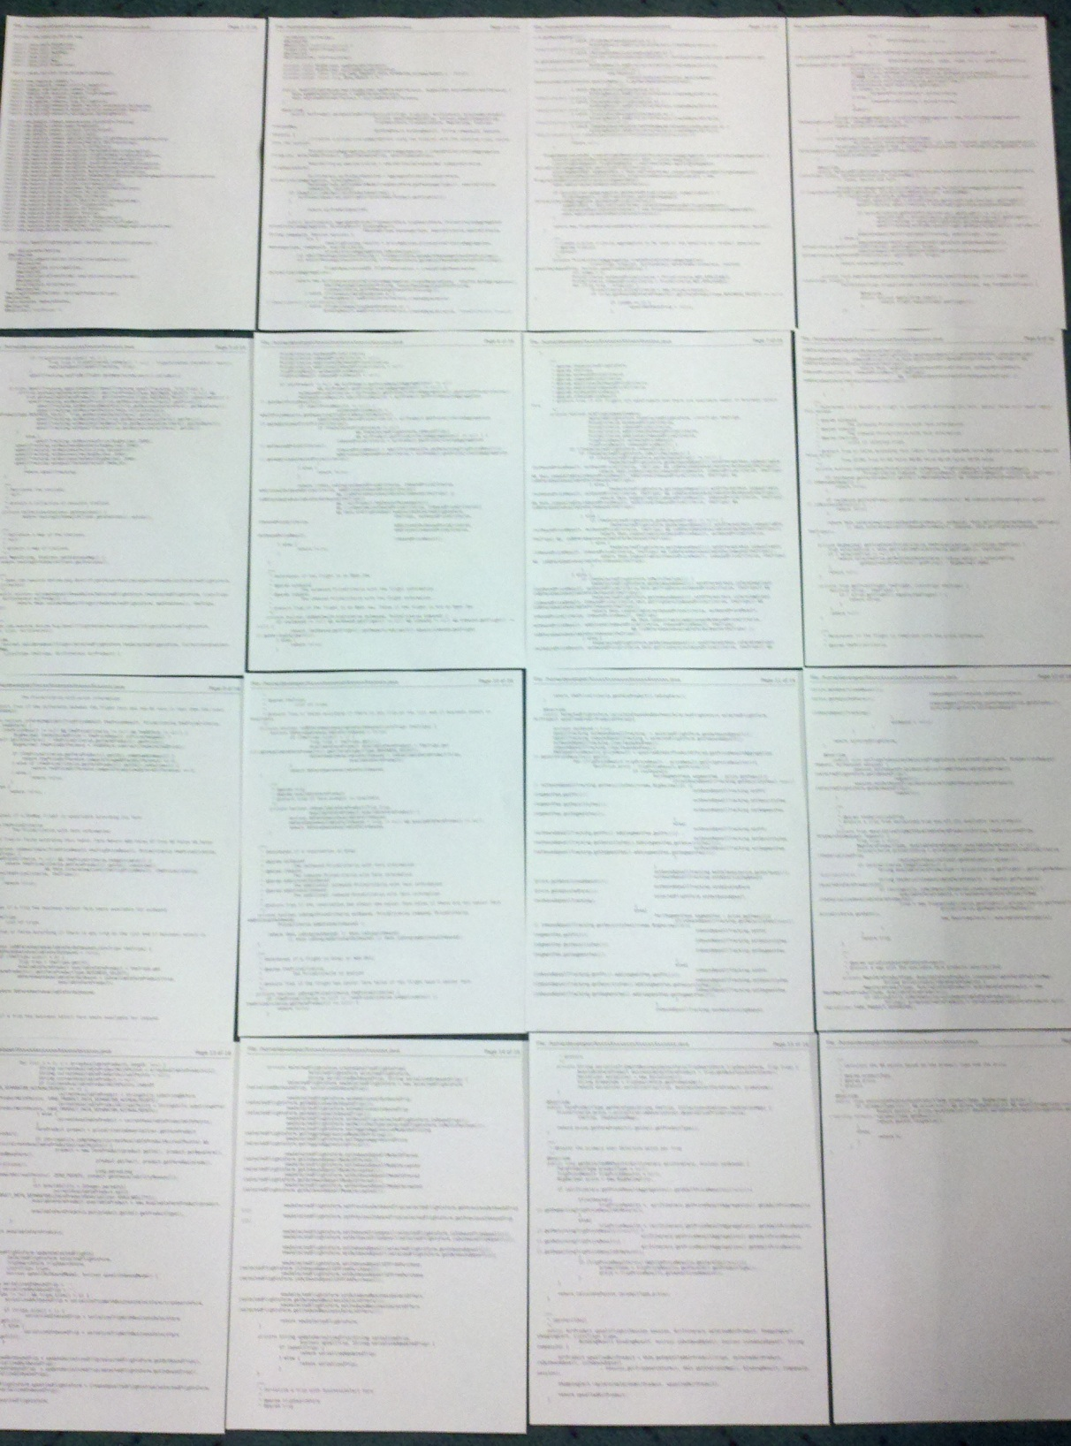
Notes:
When I came across this file, yes, that’s really the file.

Slide 5

Notes:
Wat!?

Slide 6
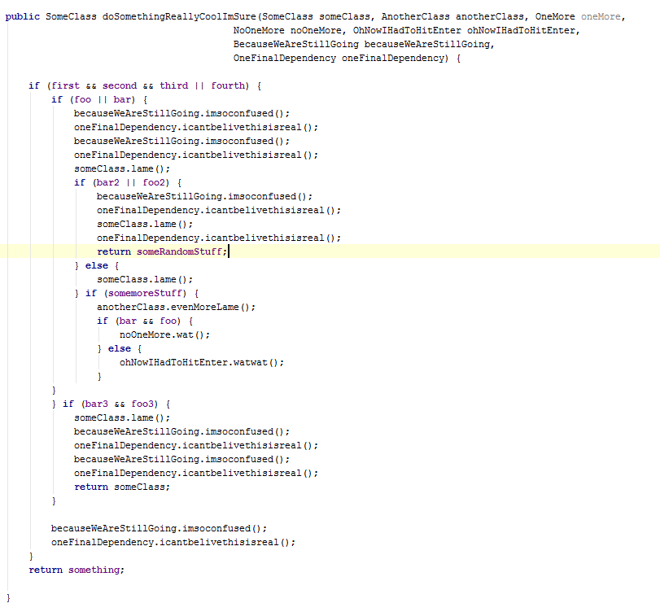
Notes:
This was the first method I saw

Slide 7
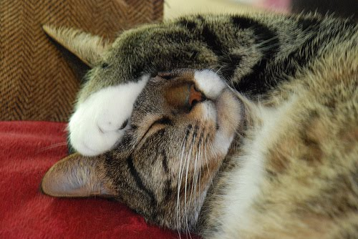
Notes:
And I was so confused, I didn’t know what was going on.

Slide 8
Notes:
And this… wait… that’s not so bad

Slide 9
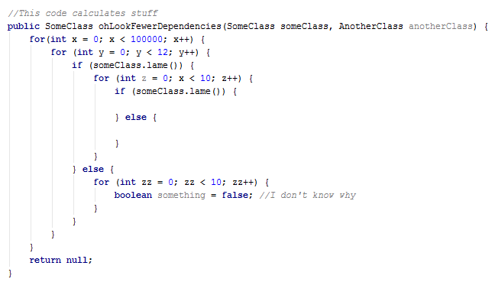
Notes:
Nevermind….

Slide 10

Notes:
Now, nothing in this world is making sense

Slide 11
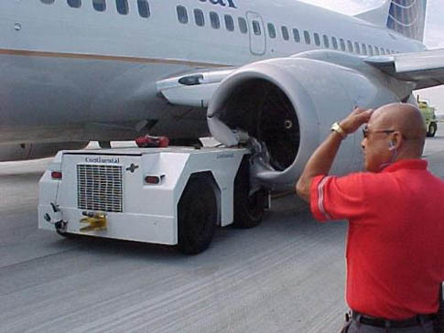
Notes:
And, I just keep thinking… How did this happen?

Slide 12
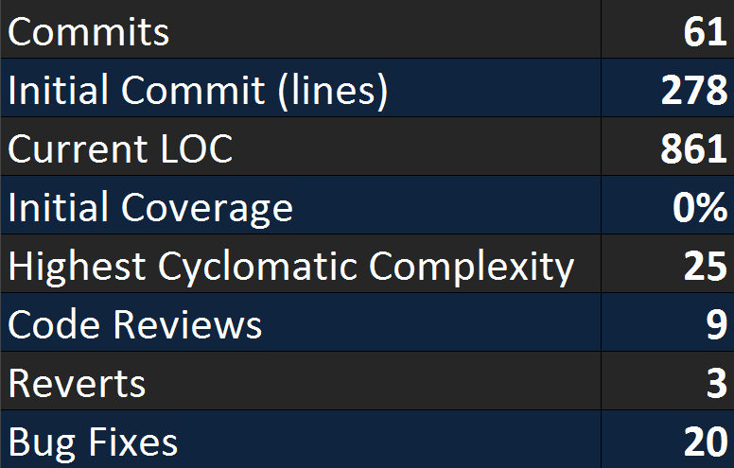
Notes:
Let’s get to the bottom of this

Slide 13

Notes:
This shouldn’t be allowed

Slide 14





Notes:
We need something to protect us from this

Slide 15
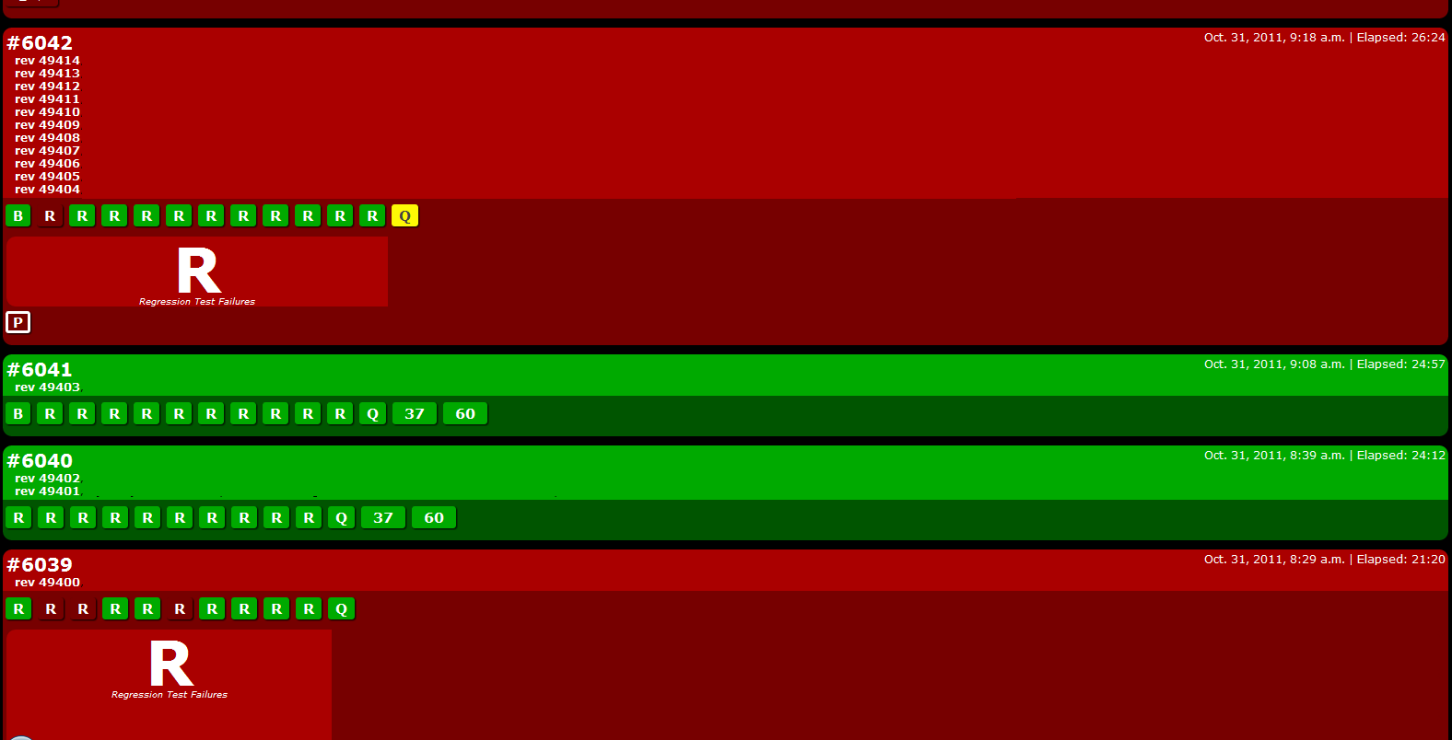
Notes:
Show Radiator

Slide 16
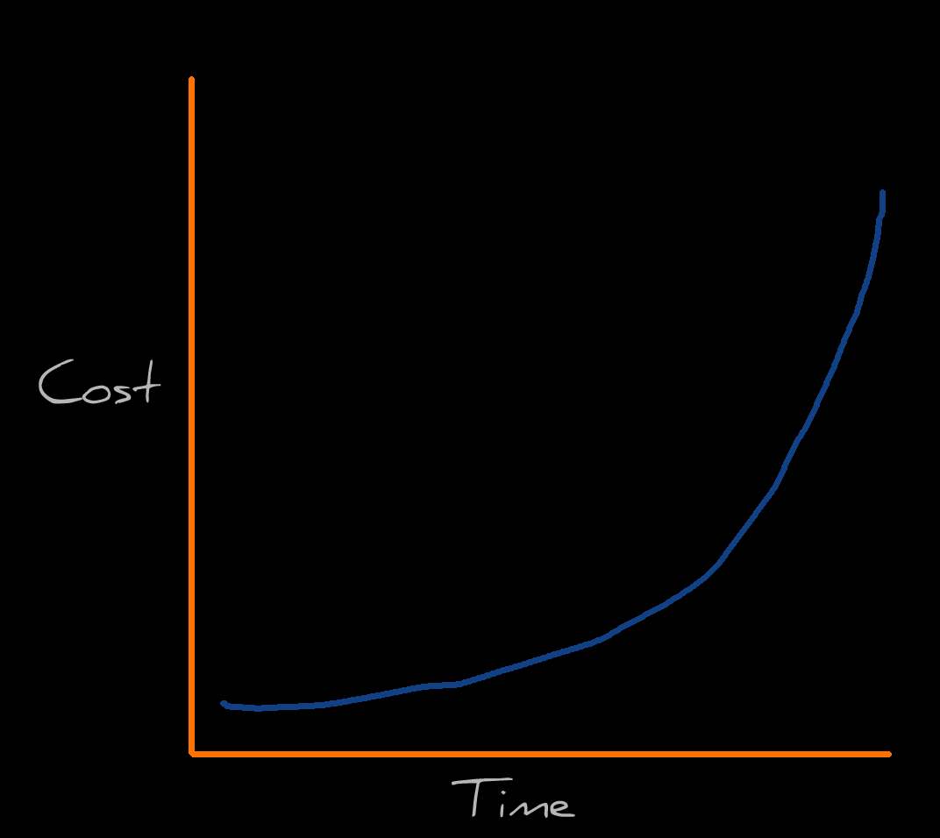
Notes:
The key here is to evaluate the risk of a checkin in real time.

Slide 17

Notes:
What heuristics are we using?

Slide 18
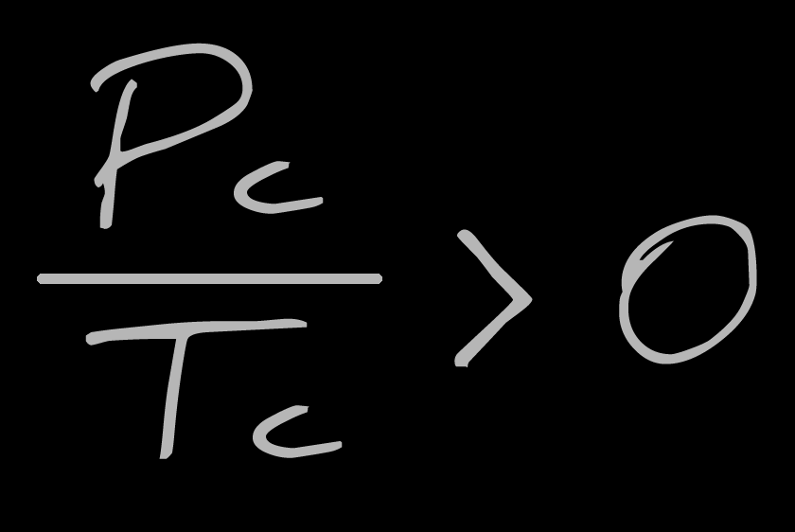
Notes:
Any test code at all?

Slide 19
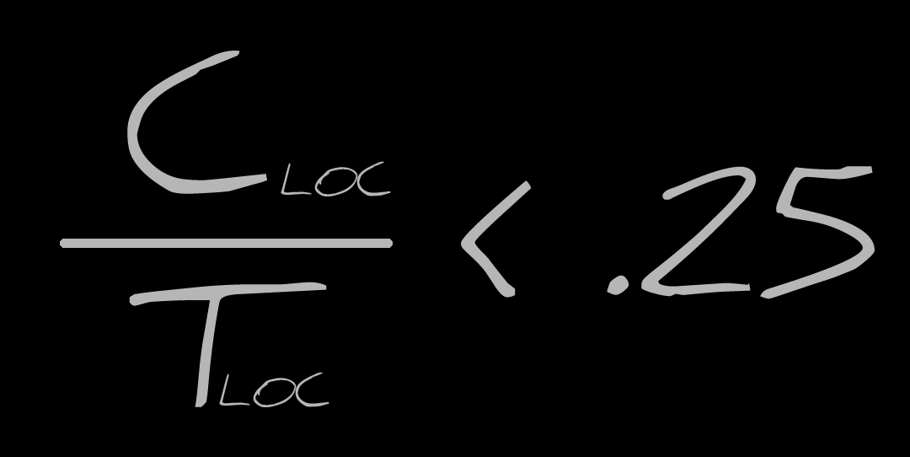
Notes:
Churn

Slide 20
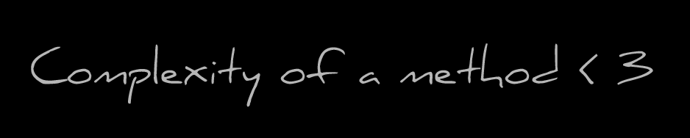
Notes:
Complexity

Slide 21
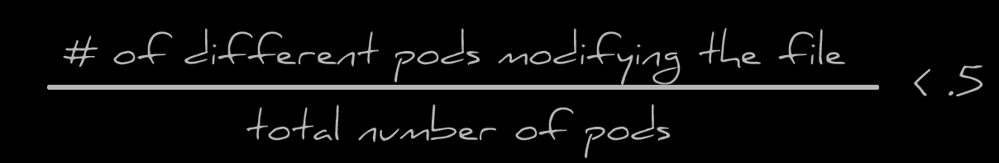
Notes:
Contributor Diversity

Slide 22
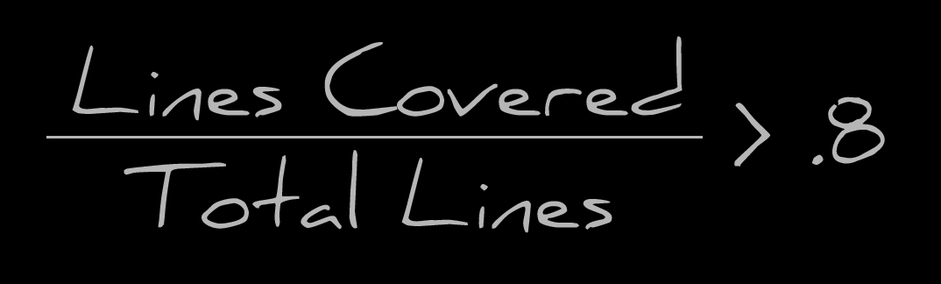
Notes:
Code Coverage

Slide 23
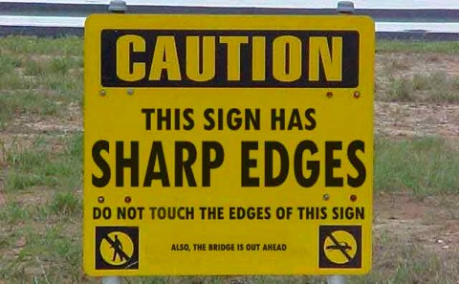
Notes:
You can run this locally, so you know what you are getting in to

Slide 24
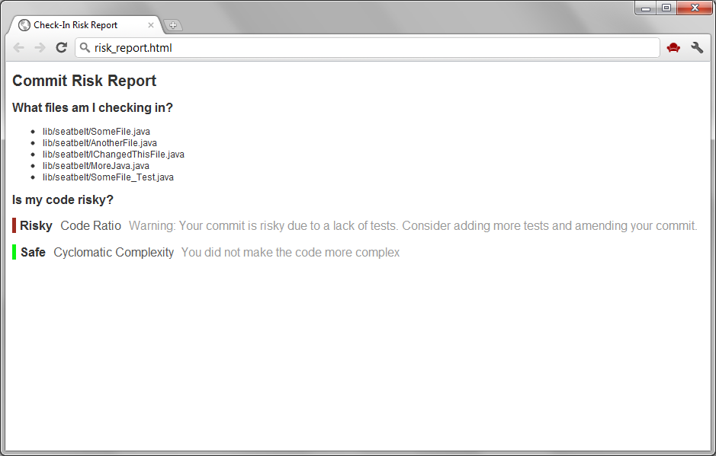
Notes:
Show Risk Report

Slide 25
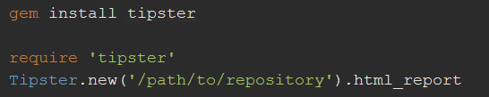
./scripts/checkin.sh <3

Slide 26
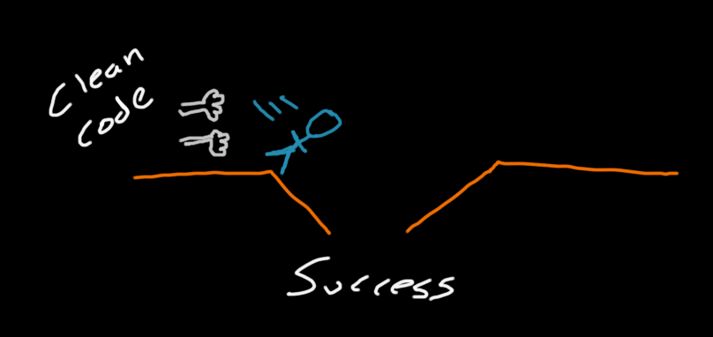
Notes:
Writing clean and maintainable code will push you in to the pit of success

Slide 27

Questions?
Search: Ratcheting on Confluence
Notes:
Questions?

